Slide 1
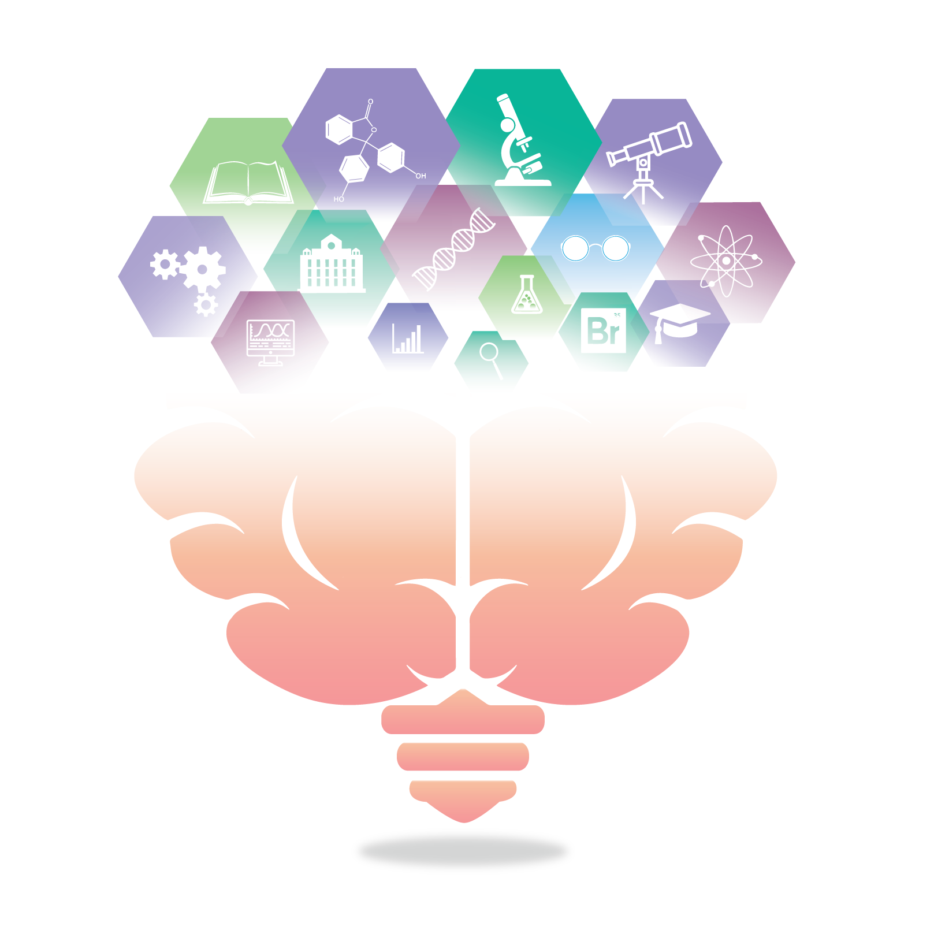



Open Science Student Support Group | OSSSG
Our Values
Integrity
Accountability, Growth, & Transparency
Collaboration
Collaboration, Recognition, & Shared Responsibilities
Equity, Diversity, & Inclusion
Accessibility, Acknowledgement, & Respect
Wellbeing
Confidentiality, Health, Privacy, & Safety
Connection
Authenticity, Compassion, Curiosity, Empathy, & Open Discussion
Who We Are?
OSSSG (Oh! - Triple S – Gee) was founded in 2020 in the Department of Psychology, University of Calgary, by a group of graduate students eager to learn about different open science practices and support each other in implementing them in our own research.
Our Vision Statement
We aim to develop a thriving student-led community that is dedicated to the promotion, normalization, and practice of open and inclusive scientific research.
Notes:
This group would not have been possible without Gwen getting the ball rolling!

Slide 2
How Does OSSSG Uphold Our Values?
 | Wellbeing | Connection | Equity, Diversity, & Inclusion | Collaboration | Integrity
 | Confidentiality, Health, Privacy, & Safety | Authenticity, Compassion, Curiosity, Empathy, & Open Discussion | Accessibility Acknowledgements, & Respect | Collaboration, Recognition, & Shared Responsibility | Accountability, Growth, & Transparency
Elaboration 1 | We prioritize mental and physical health & safety | We engage in authentic conversations | We use inclusive and respectful language | We share decision making among members | We strive to be transparent
Elaboration 2 | We respect the privacy and confidentiality of others | We ask questions instead of making assumptions | We confront the colonial history of both academia and of the land we are on | We distribute responsibility, power, and tasks | We hold ourselves accountable
Elaboration 3 | We hold a non-judgemental space | We honour where people are at on any given day | We honour intersecting identities and address privilege to achieve equity | We share knowledge, resources, ideas, and aspirations with each other | We seek and incorporate ongoing feedback
Elaboration 4 | We do not tolerate harassment of any kind | We make space for everyone’s voice to be heard | We strive to make our space and materials accessible | We value everyone’s efforts without comparisons or judgments | We promote learning and growth
Notes:
Briefly, we aim to create a space where we can come together to learn about open science practices and support each other in dealing with the frustrations and issues we face in a vulnerable, humble and mutually supportive way. To make the space welcoming to all, we use inclusive language, acknowledge our privileges, share the discussion space, refrain from making judgements, make space for a wide range of perspectives and emotions, and hold ourselves and others accountable. In line with the spirit of Open Science, this group aims to be collaborative, transparent and acknowledging of individuals’ contributions.

Slide 3
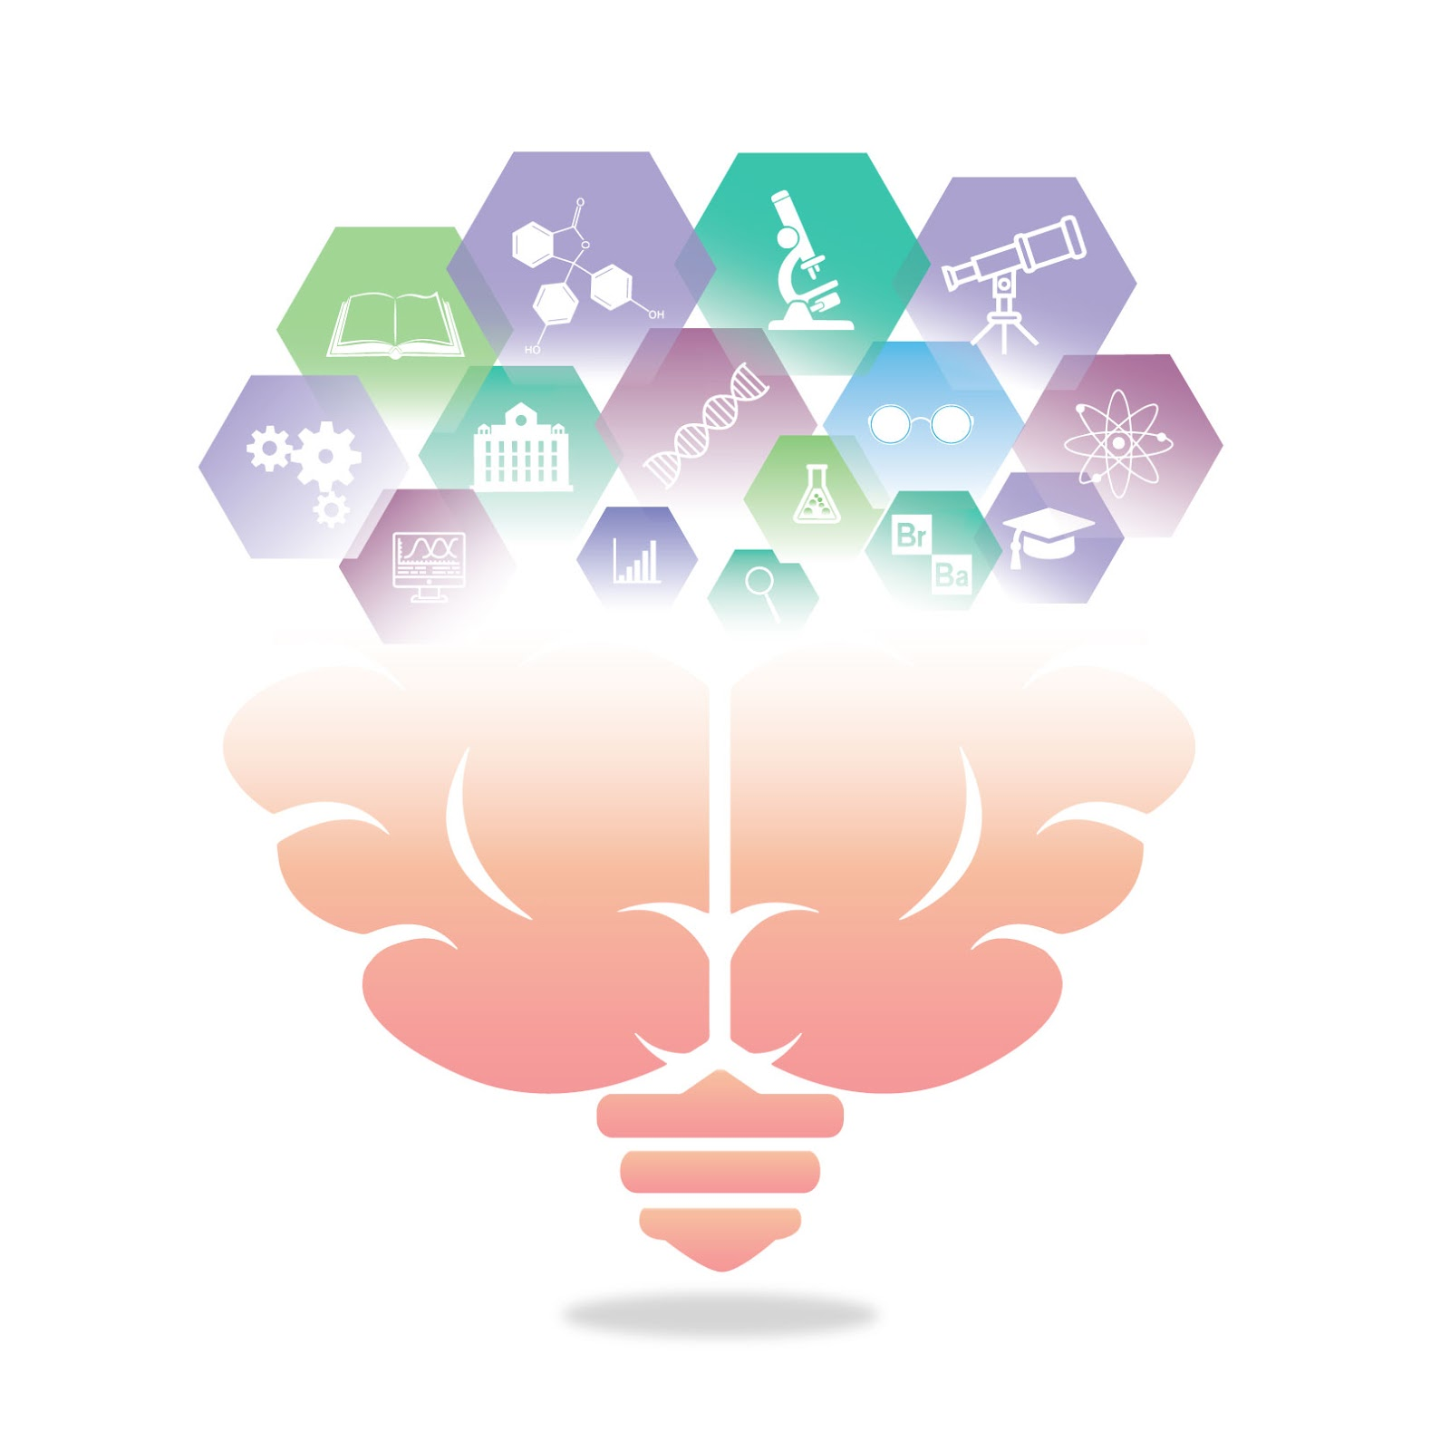
Brief intro to open science
September 16, 2021
Chelsea Moran(she/her)
(slides from Gwen Van der Wijk)
Image by Adam Douglas
©️ 2021 This work is licensed under a CC BY 4.0 license
Notes:
Chelsea, she/her - introduce
Been involved with this group since last September
Not an expert on open science! Became interested in my masters degree, been learning about it ever since and very grateful for this space to learn with others
GWEN SILDES

Slide 4
overview
Have you already learned about/used Open Science practices?
Some issues in science
Open Science: definition and purpose
Overview of Open Science practices
Barriers to & benefits of Open Science
Where to get started?

Slide 5
Some Issues in science
Restricted accessibility/paywalls to science
Questioning the reliability of science
~75% of articles are behind paywalls (~30-40% profit margins; Larivière et al., 2015; Piwowar et al., 2018)
Lack of diversity (e.g. ~80% of researchers in psychology are white; Lin et al., 2018)
Slows/restricts advances
The replication crisis (only 36% of studies replicated with half the effect size; Nosek et al., 2015)
Questionable research practices & statistical errors/misinterpretation (~50% of articles; Arnheim et al., 2019; Nuijten et al., 2015)
Publishing culture
Publication bias (Joober et al., 2012)
Publish or (and?) perish
Notes:
Open science can be conceptualized as a movement to address some of the issues facing science today
On the one hand - One big issue is the accessibility of research. About 75% of all published papers are behind paywalls, meaning that anyone not lucky enough to be part of an institution that is rich enough and willing to pay large subscription fees, cannot access the knowledge that is created through science. If you’d like to hear me rant about how outrageous publishing companies are, please ask me, but the main point here is that these restrictions significantly slow and stand in the way of scientific advance, as even many researchers don’t have access to relevant literature for their own work, let alone the public.
Then there is also a lack in accessibility in terms of who gets to participate in science. Over 80% of researchers in psychology are white, which is just one of the characteristics on which diversity is lacking, both in terms of who is doing the research as well as who participates in research - though progress is being made in terms of gender diversity. Apart from the obvious unfairness of this lack of diversity, this is problematic because everyone makes assumptions based on their own experiences and has biases, and this impacts the questions being asked, the approach taken, the variables studied, which hopefully balances out when you have a diverse range of people working on a topic, but can lead to limited and even incorrect conclusions if researchers are primarily from one demographic. Unfortunately it was in Dutch, but this podcast titled ‘why are white men geniuses? White men in research ask themselves’ nicely outlines how women entering the field of biology has lead to prominent theories being questioned and re-evaluated, which I think is a great example of the power and importance of diversity in science for getting closer to the truth we are looking for.
Questions have been raised about the credibility of scientific findings. One major problem is the replication crisis, which refers to researchers repeating experiments exactly as published, but often not finding the same results, despite increasing efforts and big samples. Overall, only about 40% of psychological studies has actually been replicated.
This is likely in part related to questionable research practices, which often revolve around manipulating or tweaking data collection, cleaning and/or analysis until you find a significant effect, only reporting what was significant or changing hypotheses after running analyses, and misuse/errors in statistics that increase the likelihood of researchers finding significant effects by chance rather than effects that are truly present.
This is combined with a publishing culture that emphasizes new, sensational findings and ignores negative findings, and puts lots of pressure on researchers to produce a great number of papers, encouraging questionable practices and the publication of fluke findings that cannot be replicated.
Francis Galton stelt in het boek English Men of Science: Their Nature and Nurture, uit 1874: is de uitzonderlijke intelligentie van Engelse mannelijke wetenschappers aangeboren of aangeleerd?
Poll: There are times when the decisions being made in a project I am involved in make me uncomfortable?

Slide 6
Importance of open science
“The Open Science Movement developed in response to the culture of secrecy and skepticism that has been pervasive throughout scientific research.”
Kathawalla et al., 2019, p3

Slide 7
What is open science?
Transparency
Accessibility
Inclusivity
Reproducibility
Reliability
Credibility
Collaboration
Image by 지우 황 under a CC BY 2.0 license
Notes:
Open science means different things
Umbrella terms for practices/goals of making science more ….

Slide 8
HOW To: Open Science Practices
Open Data & Materials
Open Access Articles
Pre-prints
Pre-Registration
Registered Reports
Notes:
Luckily people have already come up with a lot of different ways to address these issues, and have developed all kinds of tools to make it easier for others to start using these practices as well. I won’t go into depth, but I will give a bit of an overview of the main themes of open science and highlight a couple practices
Many different levels/stages of the research process. These are some examples of open science practices that are designed to make research more transparent, accessible and/or credible.
The first big, obvious theme is open access, to articles, data, code specific methods and essentially all information related to a project. Open access means materials being available free of charge to everybody, and in the best cases with licenses so they can be easily reused.
Open data: sharing de-identified data and/or the statistical analysis code in a repository so that it is freely and publicly available online
Open materials: posting study protocols, resources and workflows online
There are different ways you can make your articles open access, for example by publishing in open access journals. However, this can be quite pricy for you as an author. A simpler way, which is completely free to both you and readers, is to share your manuscript as a preprint, which is the final version of your paper before you send it in for publication.
Another big theme is transparency and increasing the robustness of methods. Project workflow is about keeping track and organizing your project in a transparent, easy to follow manner. This can foster collaboration, enhance reproducibility and minimize mistakes and biases.
You can also preregister your reports, which means that you write down a detailed plan of your study rationale and methods before you start your project. Some journals even allow you to send it to them and they then put it through peer review and if they think the project is worthwhile, they tell you to conduct the project which they will then publish whether or not the findings are significant. This shifts the focus from sensational results to proper methods, and prevents a lot of the questionable practices I mentioned before.
Another awesome practice is that of reproducible manuscripts, which basically allow you to combine your article text, code, figures and tables into one document that shows exactly what you did and why and allows others to reproduce it – we’re having a workshop about writing reproducible manuscripts on Friday at 4pm if you’re interested in hearing more!
Pre-registration: specifying a plan, such as hypothesis, primary outcome and analysis plan, in advance, before you collect/observe the data and posting it online
reduce prevalence of HARKING, spend more time planning study before executing it
Registered reports: Submit a research proposal to a journal (introduction and detailed methods section), and after revise and resubmit process, the journal may grant an in-principle acceptance, indicating that the study will be published provided the researchers complete the study as described

Slide 9
Open dissemination, discussion and collaboration
Accessible research dissemination
Breaking down existing barriers to participation in science
Reflection/advocacy
Clean bibliography (Dale Zhou)
Citation Transparency (Jeni Stiso)
Direct discussions (e.g. on Twitter, Research Gate, etc.)
(Bassett, 2020)
Notes:
The third theme I want to highlight is open dissemination, discussion and collaboration.
Most of science is funded publicly, and it is intended to provide solutions and advances to society, so it only makes sense to no only make research findings openly available in their academic format, but also present it to the communities it relates to in an understandable way. This can also open the dialogue between researchers and the community to increase their input and with that the real-world impact of research.
In a similar vain, participation in science should be made more open and accessible, which involves breaking down existing barriers and systemic inequalities that prevent equal participation from people from different parts of the world, different races, genders, abilities, sexual orientations and depending on financial circumstances. While this is difficult for any one person to change, I think we can all play our part by learning and reflection on our own biases and roles in the current system and explicitly advocate for change, even if it’s just within our labs/collaborations. I also found these two tools related to citation practices which are tiny but potentially helpful: clean bibliography is a code book that tells you the estimated breakdown of the race and gender of the first and last authors you cite in your reference list, while citation transparency is an add-on for Chrome that, whenever you do a search in google scholar, shows you the estimated gender of the first and last author of the papers you’re looking at.
Lastly, science can also be made more open by having more direct discussions in open spaces, for example on Twitter or Research Gate.
~ 75 sec

Slide 10
Barriers to open science
“It is an unfortunate irony that open-science practices are not equally accessible to all scientists”
Bahlai et al., 2019, p79-80
Career stage/job stability
Systemic inequalities
Core values over ‘all-or-nothing’ approach
Notes:
While open science practices have many benefits and aim to resolve the issues I mentioned earlier, it is by no means perfect or the end goal. Already, some issues have been raised, for example by Bahlai et al., who say:
One of the barriers is being an early career researcher or facing job instability, as in this case you greatly depend on supervisors and institutions for chances of future success. Some supervisors might be supportive or even teaching you open science practices, while others resist or refuse to adopt them. Though I know little about it, my current understanding is that hiring and continuation contracts heavily depend on how much and where you publish, so investing your time in open science practices and publishing in open access journals, which for now, tend to have lower impact factors, might be detrimental to your chances of getting/retaining a job.
In addition, the systemic inequalities based on race, gender and ability, among others, that are present throughout our society are also present in the open science movement. Together with often related limited time and money, these present significant barriers to participating in open science, therefore it is important not to adopt an ‘all or nothing’ approach to open science, which is exemplified for example by privileged researchers ridiculing/calling out less privileged researchers for not being ‘open enough’. Instead, I think we should focus on the core values of open science and work to help everyone with the steps they can take in their circumstances, and reward that.
In general, I think it’s important to keep being critical and open to new ideas and perspectives, and look for ways to continuously evaluate and improve practices
~130 sec

Slide 11
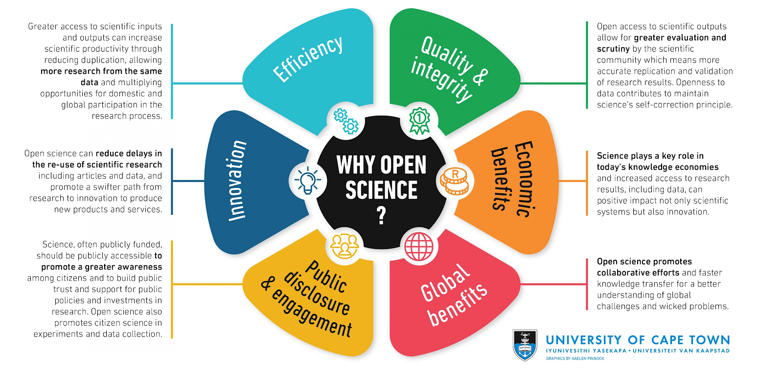
Benefits of open science
This image was created by Gealen Pinnock for the Research Support Hub of the University of Cape Town and is licensed under a Creative Commons Attribution 4.0 International License. This image can be found at http://www.researchsupport.uct.ac.za/why-open-science. No modifications were made.
Notes:
With that in mind, I want to go over some of the benefits of Open Science. Overall, Open science has a broad range of benefits. Perhaps most importantly, it improves the quality and integrity of research, but it also spurs innovation and efficiency, and aims to foster better communication and interaction with both global and local communities, leading to greater societal impact of research findings and a broader range of perspectives, populations and issues being studied.
~ 30 sec

Slide 12
Benefits for you
Being part of an cooperative global research community
Access to feedback, data, code, collaborators, etc. (Allen & Mehler, 2019)
Great investment in your future (Allen & Mehler, 2019)
Science is on the way to being open
Open science skills transfer to non-academic careers
Open access articles receive 18% more citations (Piwowar et al., 2018)
Greater chance of publishing null findings (Allen & Mehler, 2019)
Notes:
In addition to contributing to better science practices, open science also has benefits for you more directly. For example, open science let’s you be part of a cooperative global research community, which gives you access to feedback, data, code, collaborators and much more
It’s also a great investment in your future. If you stay in academia, it is probably beneficial to start adopting these practices as soon as you can, as we are already moving towards becoming more open. If you don’t stay in academia it can also be a really good investment, as open science skills generally translate well to non-academic careers.
In addition, open access articles receive more citations, so publishing that way can be great for getting more ‘points’ in the current system, and you can prevent risking to do a lot of work on a project which might not lead to a publication in the end, if the findings aren’t interesting enough, as you have a greater chance of publishing null (and any kind of) findings through open science
~ 70 sec

Slide 13
Where to get started?
Where ever you’re at!
Resources are plentiful - read/listen/watch something about Open Science
A guide to open science for people who are already too busy
Talk to your collaborators about Open Science
E.g. share and discuss the article by Kathawalla et al. (2020) with your lab
Pick a practice and set a small, concrete goal, e.g.
Post a preprint (e.g. on PsyArXiv – more about preprints)
Create an Open Science Framework account (set up a project and upload/organize your files)
Fill out a preregistration form for your next project (OSF, AsPredicted)
Join OSSSG
Intro to open science talk from last year: https://osf.io/b86nq/
Notes:
My experiences so far – a lot more is possible that I expected if I just asked
The Open science framework is a great Open Science platform/tool where you can organize your files, keep track of projects, share files with collaborators and the general public and preregister studies

Slide 14
Resources
Listen (podcasts):
Open science talks: What is open science? (~15 minutes)
Radiolab: Stereothreat (~40 min)
Research Matters: Embracing an open science mindset (~60 min)
The black goat: It’s so complicated (~70 min)
Watch (videos):
Ted Talk about current research culture and open science as a solution: Research Culture is Broken: Open Science can Fix It (~15 min)
Lecture on open science: Open Science is just good science (~40 min)
Webinar on open science by Brian Nosek, Executive Director and Co-Founder of Center for Open Science (COS): Open Science (~60 min)

Slide 15
Resources
Read (articles/papers):
Bahlai, C., Bartlett, L. J., Burgio, K. R., Fournier, A., Keiser, C. N., Poisot, T., & Whitney, K. S. (2019). Open science isn’t always open to all scientists. American Scientist, 107(2), 78-82.
Kathawalla, U., Silverstein, P., & Syed, M. (2020, May 8). Easing Into Open Science: A Guide for Graduate Students and Their Advisors. https://doi.org/10.31234/osf.io/vzjdp
Monbiot, G. (2011). Academic publishers make Murdoch look like a socialist. The Guardian, 29, 8. http://wavelets.ens.fr/BOYCOTT_ELSEVIER/ARTICLES/2011_08_29_The_Guardian.pdf
Blogpost + discussion: The grad student who never said ‘no’
Great overview of more resources presented in a tiered way so you can select what you have time for: A Guide for Open Science for People Who Are Already Too Busy
More resources, tutorials and step-by-step guides on open science practices: https://osf.io/w5mbp/wiki/home/
Notes:
Link to slides: https://osf.io/yxmfj/

Slide 16
References
Allen, C. & Mehler, DMA. (2019). Open science challenges, benefits and tips in early career and beyond. PLoS Biol 17(5): e3000246. https:// doi.org/10.1371/journal.pbio.3000246
Amrhein, V., Greenland, S., & McShane, B. (2019). Scientists rise up against statistical significance.
Bahlai, C., Bartlett, L. J., Burgio, K. R., Fournier, A., Keiser, C. N., Poisot, T., & Whitney, K. S. (2019). Open science isn’t always open to all scientists. American Scientist, 107(2), 78-82.
Bassett, D. (2020, December 2). State transitions in matter and mind [Video]. Youtube. https://www.youtube.com/watch?v=WN6moTxEMNc&t=2010s
Botvinik-Nezer, R., Holzmeister, F., Camerer, C. F., Dreber, A., Huber, J., Johannesson, M., ... & Rodriguez-Thompson, A. (2019, November). Variability in the analysis of a single neuroimaging dataset by many teams. Doi: https://doi.org/10.1101/843193
Bumpus, N. (2020). Too many senior white academics still resist recognizing racism. Nature, 583(7818), 661-661.
Joober, R., Schmitz, N., Annable, L., & Boksa, P. (2012). Publication bias: what are the challenges and can they be overcome?. Journal of psychiatry & neuroscience: JPN, 37(3), 149.
Larivière, V., Haustein, S., & Mongeon, P. (2015). The oligopoly of academic publishers in the digital era. PloS one, 10(6), e0127502.
Lin, L., Stamm, K., & Christidis, P. (2018). How diverse is the psychology workforce. Monitor on Psychology, 49(2), 19.
Nosek, B. A., Aarts, A. A., Anderson, J. E., Kappes, H. B., & Open Science Collaboration. (2015). Estimating the reproducibility of psychological science. Science, 349(6251), aac4716-aac4716.
Nuijten, M. B., Hartgerink, C. H., van Assen, M. A., Epskamp, S., & Wicherts, J. M. (2016). The prevalence of statistical reporting errors in psychology (1985–2013). Behavior research methods, 48(4), 1205-1226.
Piwowar, H., Priem, J., Larivière, V., Alperin, J. P., Matthias, L., Norlander, B., ... & Haustein, S. (2018). The state of OA: a large-scale analysis of the prevalence and impact of Open Access articles. PeerJ, 6, e4375.
Tennant, J [DARIAH-EU]. (2018, June 1). Open Science is just good science [Video]. Youtube. https://www.youtube.com/watch?v=UEEcwRUgQu8&feature=emb_title.
Wellmon, C., & Piper, A. (2017). Publication, power, and patronage: On inequality and academic publishing. Critical Inquiry, 21.

